Slide 1
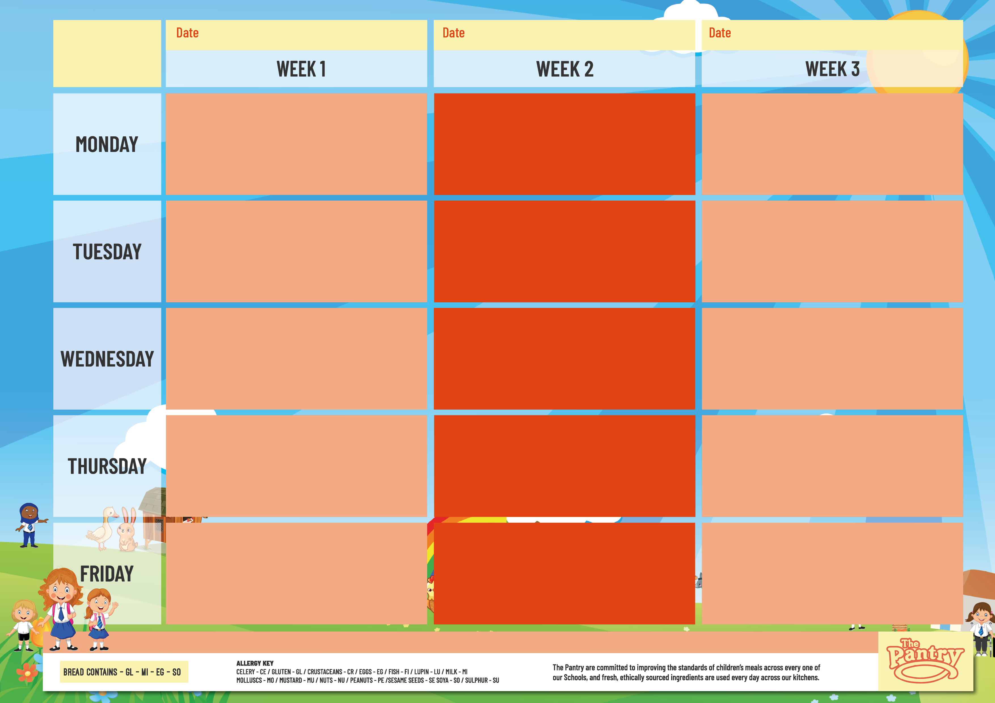
31st Aug, 21st Sep, 12th Oct, 2nd Nov, 23rd Nov,
14th Dec, 4th Jan, 25th Jan, 15th Feb
7th Sep, 28th Sep, 19th Oct, 9th Nov,
30th Nov, 21st Dec, 11th Jan, 1st Feb, 22nd Feb
14th Sep, 5th Oct, 26th Oct, 16th Nov
7th Dec, 28th Dec, 18th Jan, 8th Feb
CASTILION
Handmade Margherita Pizza with Wedges (GL,MI)
Vegetable Frittata with Wedges (EG,MI)
Tomato Pasta (GL)
Jacket Potatoes – Cheese (MI), Beans or Tuna (FI)
Baguettes-Ham (GL,SO), Cheese (GL,MI,SO) or Tuna (GL,SO,FI)
Ice Cream (MI) or Fresh Fruit
Mac n Cheese (GL,MI)
Mild Veggie Chilli Wrap with Golden Rice (GL,SO)
Tomato Pasta (GL)
Jacket Potatoes – Cheese (MI), Beans or Tuna (FI)
Baguettes-Ham (GL,SO), Cheese (GL,MI,SO) or Tuna (GL,SO,FI)
Apple & Raisin Biscuit (GL) or Fresh Fruit
Handmade Margherita Pizza with Wedges (GL,MI)
Vegetable Dahl with Steamed Rice (GL)
Tomato Pasta (GL)
Jacket Potatoes – Cheese (MI), Beans or Tuna (FI)
Baguettes-Ham (GL,SO), Cheese (GL,MI,SO) or Tuna (GL,SO,FI)
Creamy Rice Pudding with Fruit Sauce (MI) or Fresh Fruit
Chicken Meatballs with Tomato & Basil Sauce & Rice
Vegetable Biryani with Carrot & Raisin Salad (GL)
Tomato Pasta (GL)
Jacket Potatoes – Cheese (MI), Beans or Tuna (FI)
Baguettes-Ham (GL,SO), Cheese (GL,MI,SO) or Tuna (GL,SO,FI)
Lemon Drizzle Cake (GL,SU) or Fresh Fruit
Chicken Korma with Steamed Rice
Cheesy Baked Bean Quesadilla (GL,MI)
Tomato Pasta (GL)
Jacket Potatoes – Cheese (MI), Beans or Tuna (FI)
Baguettes-Ham (GL,SO), Cheese (GL,MI,SO) or Tuna (GL,SO,FI)
Marble Cake with Custard (GL,MI) or Fresh Fruit
Mild Beef Chilli with Rice (GL)
Veggie Pasta Bake (GL,MI)
Tomato Pasta (GL)
Jacket Potatoes – Cheese (MI), Beans or Tuna (FI)
Baguettes-Ham (GL,SO), Cheese (GL,MI,SO) or Tuna (GL,SO,FI)
Apple Crumble Cake with Custard (GL,MI) or Fresh Fruit
Roast Gammon with Potatoes & Gravy (SU)
Roasted Vegetable Loaf with Potatoes & Gravy (GL,SU)
Tomato Pasta (GL)
Jacket Potatoes – Cheese (MI), Beans or Tuna (FI)
Baguettes-Ham (GL,SO), Cheese (GL,MI,SO) or Tuna (GL,SO,FI)
Fruity Shortbread (GL) or Fresh Fruit
Roast Chicken Breast with Potatoes & Gravy (SU)
Squash & Sweet Potato Wellington with Potatoes & Gravy (GL,SU)
Tomato Pasta (GL)
Jacket Potatoes – Cheese (MI), Beans or Tuna (FI)
Baguettes-Ham (GL,SO), Cheese (GL,MI,SO) or Tuna (GL,SO,FI)
Super Oaty Flapjack (GL) or Fresh Fruit
Pork Sausage Roast with Potatoes & Gravy (GL,SO,SU)
Veggie Sausage Roast with Potatoes & Gravy (SO,SU)
Tomato Pasta (GL)
Jacket Potatoes – Cheese (MI), Beans or Tuna (FI)
Baguettes-Ham (GL,SO), Cheese (GL,MI,SO) or Tuna (GL,SO,FI)
Oaty Biscuit (GL) or Fresh Fruit
Pastry Topped Chicken Pie With Mashed Potato (GL,MI)
Veggie Pasta Bolognaise (GL,SO)
Tomato Pasta (GL)
Jacket Potatoes – Cheese (MI), Beans or Tuna (FI)
Baguettes-Ham (GL,SO), Cheese (GL,MI,SO) or Tuna (GL,SO,FI)
Vegan Fruit Jelly or Fresh Fruit
Creamy Salmon Tortellini (GL,MI,FI)
Handmade Margherita Pizza with Wedges (GL,MI)
Tomato Pasta (GL)
Jacket Potatoes – Cheese (MI), Beans or Tuna (FI)
Baguettes-Ham (GL,SO,), Cheese (GL,MI,SO) or Tuna (GL,SO,FI)
Vanilla Cookie (GL) or Fresh Fruit
Beef Pasta Bolognaise (GL)
Veggie Cottage Pie (GL,SO,MI)
Tomato Pasta (GL)
Jacket Potatoes – Cheese (MI), Beans or Tuna (FI)
Baguettes-Ham (GL,SO), Cheese (GL,MI,SO) or Tuna (GL,SO,FI)
Iced Sprinkle Sponge (GL) or Fresh Fruit
Breaded Fish Fingers with Chips & Beans (GL,FI)
Veggie Fingers with Chips & Beans (GL)
Tomato Pasta (GL)
Jacket Potatoes – Cheese (MI), Beans or Tuna (FI)
Baguettes-Ham (GL,SO) Cheese (GL,MI,SO) or Tuna (GL,SO,FI)
Dessert Bar (GL,MI,SU) or Fresh Fruit
Crispy Chicken Bites with Chips & Beans (GL)
Crispy Vegan Nuggets with Chips & Beans (GL)
Tomato Pasta (GL)
Jacket Potatoes – Cheese (MI), Beans or Tuna (FI)
Baguettes- Ham (GL,SO) Cheese (GL,MI,SO) or Tuna (GL,SO,FI)
Dessert Bar (GL,MI,SU) or Fresh Fruit
Oven Baked Battered Fish with Chips & Beans (GL,FI)
Handmade Cheese & Onion Pasty with Chips & Beans (GL,MI)
Tomato Pasta (GL)
Jacket Potatoes – Cheese (MI), Beans or Tuna (FI)
Baguettes- Ham (GL,SO) Cheese (GL,MI,SO) or Tuna (GL,SO,FI)
Dessert Bar (GL,MI,SU) or Fresh Fruit
VEGETABLES, SALAD, BREAD, AVAILABLE DAILY

